Slide 1
Attribute-Bound EDW Access
Tom Deaderick

Slide 2
Attribute-binding EDW Access
Current state
Users are provisioned with access to specific EDW (Enterprise Data Warehouse) domains by identity (identity-bound).
Access is authorized by business data steward, processed by security and implemented by DBAs.
Access provisioning & deprovisioning requires substantial management.
Desired state
Convert from identity-bound access to attribute-bound access.
Access authorizations are bound to attribute and attribute combinations rather than identities.
Triggers provision and deprovision access daily, based on attribute-binding table, without human intervention.

Slide 3
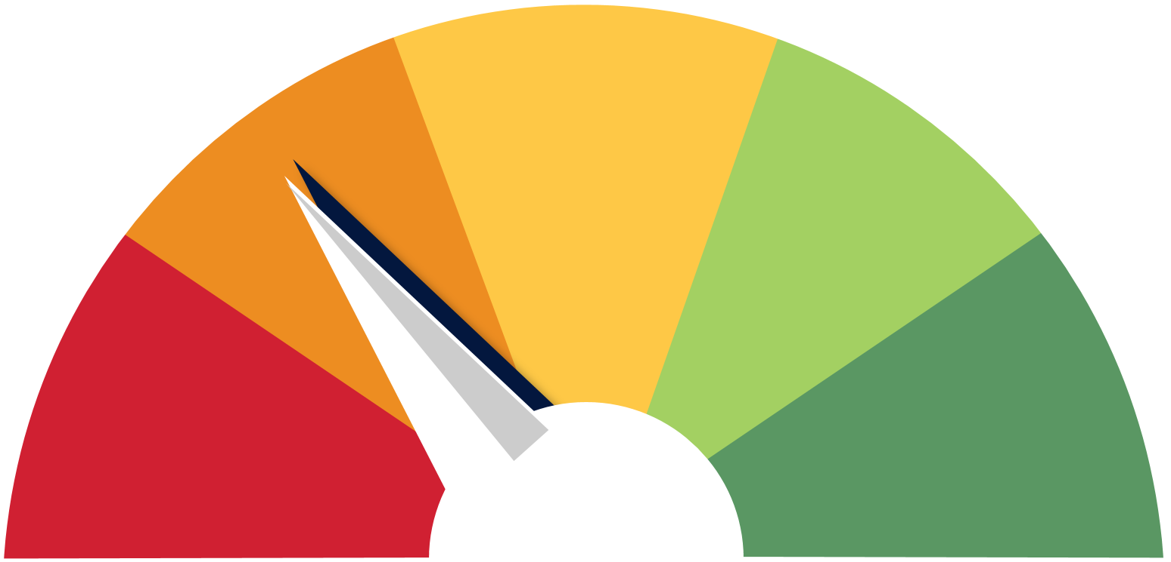
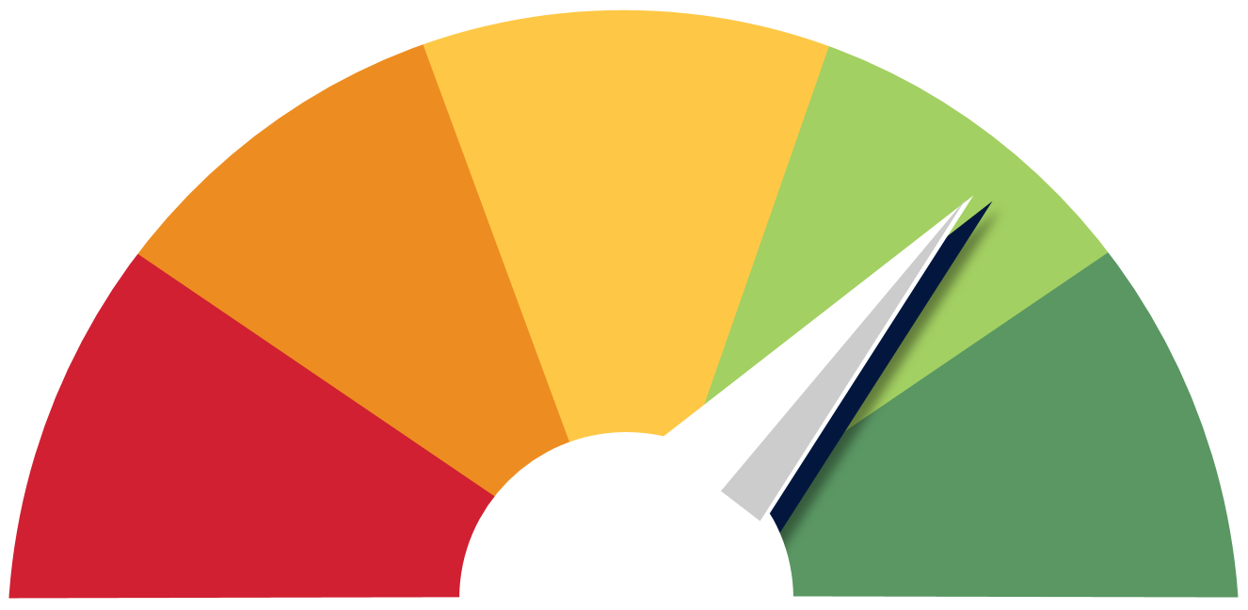
Vision
Interactive
Processing
(Current process)
Requests submitted, evaluated by business and provisioned
Automated
Processing
Automated provisioning and deprovisioning using business rules and employee attributes
Now: Few automated
Future: Many automated
Strategic goals
Every interactive provision feeds data into recurring peer analysis, with future identical requests fulfilled by automation.

Slide 4
Objectives
Streamline and automate access request process.
Strengthen binding between business rules and controls.
Automate provisioning and deprovisioning for commonly-held access.
Protecting Big Data with Big Data.
Cybersecurity impact
- Reduced variability
- Automated provisioning

Slide 5
Peer analysis: basics
Evaluate employees with the matching attributes.
Line of business, Division, Market, Job Code, etc.
36 Employees have a specific data domain
8 Employees do not
Threshold approach:
If > 80% of employees with same attributes have access, attribute-binding is considered.

Slide 6
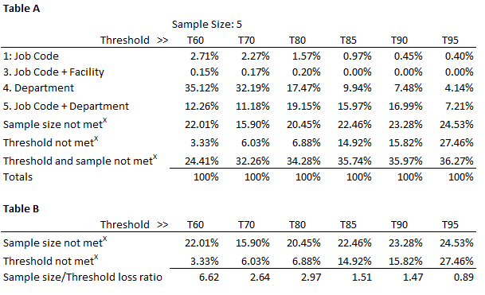
Peer Analysis
Definitions
A provision is an association of DB domain access to a user.
Attribute-bindable ("bindable") a provision that exceeds threshold and sample requirements in peer analysis.
Table A
Percentage of provisions that are bindable to each attribute/combination.
Table B
Compares percentage of missed binding opportunities due to threshold and sample size.
Table C
Impact of decreasing sample size requirements on binding opportunities.
Findings
Increasing threshold reduces binding opportunities (Table A).
There is a substantial decrease in binding opportunities between the 80% (6.88%) and 85% (14.92%) threshold (Table B) and a minimal change between 70% and 80%, suggesting that an 80% threshold is ideal.
Small sample sizes restrict attribute-binding more than thresholds (Table B). Table C suggests setting minimum sample size to 3 to capture more recommendations for interview approvals.

Slide 7
Implementation process
Peer Analysis
Attribute-Based access analysis.
Recommendations
Providing employees who have the same attributes, the same access.
Leadership Review
Review recommendations for added access with managers.
Logic adjustments
Automated access enables increased attribute granularity (if required) without creating additional direct provisioning labor.
Business Data Steward Review
Obtain authorization from the Business Data Steward for access by attribute, without human interaction.
Implementation
EDW DBAs implement automated provisioning and deprovisioning.
Peer Analysis
Recommendations
Leadership Review
Logic Adjustments
Business Data Steward Review
Implementation

Slide 8
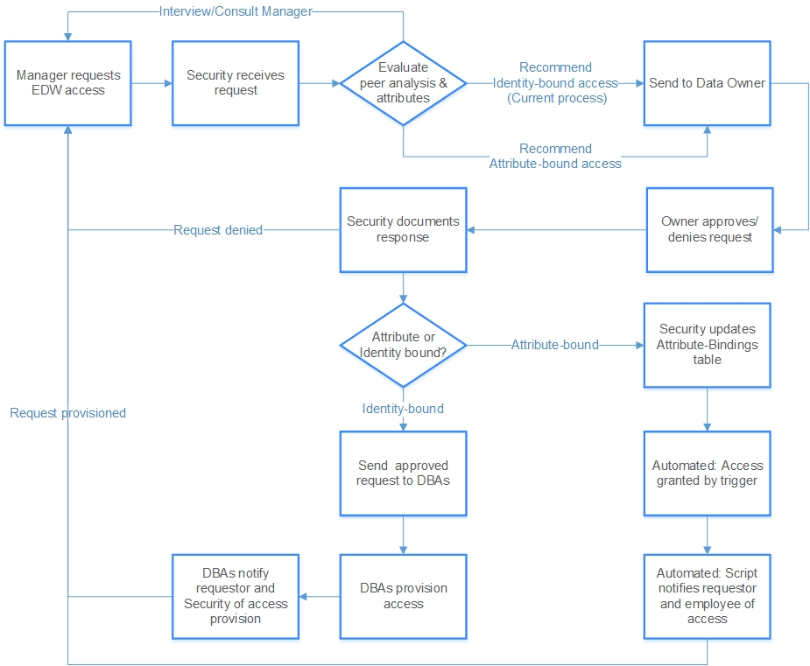
Overview of future process

Slide 9
Navigating the reports
Five target attributes & combinations
Goal: Provide access to the attribute with the greatest population (reducing management costs).
Job code
Job code + Market
Job code + Facility
Department
Job code + Department
Threshold
Do 80% of people with a given attribute, or attribute combination, have this access?
Minimum sample size
Are there at least 3 people with the attribute, or combination, who have the access?
Try
Try
Try
Try
Report contents
Organizational Attributes
Personal Attributes
Database Provision
Counts/Percentages
Attributes of an employee's division, market, facility, department, etc.
An employee's personal attributes; job class, job code, position, etc.
Specific database provisions recommended by peer analysis.
Number of employees with same attributes,
Number of those with access,
% that have access vs need access.

Slide 10
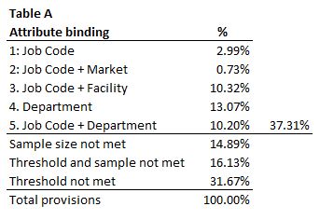
Results
Removal of at least 37% labor, benefiting requestors, data stewards, Security and DBAs.
Employees with authorized attribute bindings receive day one access without a request.
Access is automatically deprovisioned when employee attributes change.
Assured connection of business objectives and access provision.
Reduced process variability.

Slide 11
Attribute-Bound EDW Access
Tom Deaderick

